Slide 1
WiE WSF TSC WL Performance Template V2.0 <WL Name><WL Domain>
Presenter Name
xPSD – Workload Integration and Enabling (WiE) team
Month Day, Year

Slide 2
WL Performance - Content Guidance
Performance Scope/Story/Message:
WL introduction
HW/SW/WL configuration
Performance Measuring and Monitoring Tools Notes:
Bare metal scaling (ICX)
Reference Comparison:
Logical core scaling and Application instance scaling:
Analysis, Debug and Optimization:
Cloud Scaling (ICX)
Reference Comparison:
VM instance(vCPU) scaling and Application instance scaling:
Analysis, Debug and Optimization
Gen-To-Gen Comparison (ICX vs SPR)
Competitive Analysis
Conclusion and Next Step:
2

Slide 3
WL Performance – WL Scope
WL Scope: Bare Metal /Cloud/ Gen-to-Gen Comparison, Competitive Analysis
Bare Metal? Platform?
Cloud? VM instance? AWS? GCP? Azure? Ali? Tencent?
Gen-to-Gen Comparison?
Competitive Analysis? AMD? ARM?
WL Summary
What is the story line in this report?
Which message you would like to pass to the audience?
Your own experiment and result might be much more than the results in this report.
3

Slide 4
WL Performance – WL introduction
WL architecture, Use scenarios, Test architecture, Test Case, KPI, resource usage.
4

Slide 5
WL Performance – System Configuration
Name | SM-ICX5-6348 | SM-CLX-8268 | BDW-E5-2699A v4 | SM-Milan-2U
Time | Thu Sep 30 17:53:29 UTC 2021 | Thu Sep 30 17:54:04 UTC 2021 | Thu 30 Sep 2021 05:51:41 PM UTC | Thu Sep 30 17:55:22 UTC 2021
Manufacturer | Supermicro | Intel Corporation | Intel Corporation | Supermicro
Product Name | SYS-220U-TNR | S2600WFT | S2600TPFR | AS -2124US-TNRP
BIOS Version | 1.1 | SE5C620.86B.02.01.0013.121520200651 | SE5C610.86B.01.01.0029.052820200607 | 2.1
OS | CentOS Linux 8 | Red Hat Enterprise Linux 8.4 (Ootpa) | Ubuntu 20.04.2 LTS | Red Hat Enterprise Linux 8.4 (Ootpa)
Kernel | 4.18.0-305.12.1.el8_4.x86_64 | 4.18.0-305.12.1.el8_4.x86_64 | 5.4.0-81-generic | 4.18.0-305.19.1.el8_4.x86_64
Microcode | 0xd0002a0 | 0x5003102 | 0xb00003e | 0xa00111d
IRQ Balance | Enabled | Disabled | Enabled | Enabled
CPU Model | Intel(R) Xeon(R) Gold 6348 CPU @ 2.60GHz | Intel(R) Xeon(R) Platinum 8268 CPU @ 2.90GHz | Intel(R) Xeon(R) CPU E5-2699A v4 @ 2.40GHz | AMD EPYC 7543 32-Core Processor
Base Frequency | 2.6GHz | 2.9GHz | 2.4GHz | 2.8GHz
Maximum Frequency | 3.5GHz | 3.9GHz | 3.6GHz | 2.8GHz
All-core Maximum Frequency | 3.4GHz | 3.5GHz | 3.0GHz
CPU(s) | 112 | 96 | 88 | 128
Thread(s) per Core | 2 | 2 | 2 | 2
Core(s) per Socket | 28 | 24 | 22 | 32
Socket(s) | 2 | 2 | 2 | 2
NUMA Node(s) | 2 | 2 | 2 | 2
Prefetchers | DCU HW, DCU IP, L2 HW, L2 Adj. | DCU HW, DCU IP, L2 HW, L2 Adj. | DCU HW, DCU IP, L2 HW, L2 Adj.
Turbo | Enabled | Enabled | Enabled | Disabled
PPIN(s) | 627840dc542f7a5c, 628e58dc92d28dbb |  | aaff4e59ba24af8f, aaff3ffb53efa98d
Power & Perf Policy | Performance | Performance | Performance
TDP | 235 watts | 205 watts | 145 watts
Frequency Driver | intel_pstate | intel_pstate | intel_pstate | acpi-cpufreq
Frequency Governer | performance | performance | powersave | performance
Frequency (MHz) | 3400 | 3503 | 1335 | 2755
Max C-State | 9 | 9 | 9 | 9
Installed Memory | 1024GB (16x64GB DDR4 3200MT/s [3200MT/s]) | 384GB (12x32GB DDR4 2666MT/s [2666MT/s]) | 256GB (8x32GB DDR4 2667MT/s [2400MT/s]) | 1024GB (16x64GB DDR4 3200MT/s [3200MT/s])
Huge Pages Size | 2048 kB | 2048 kB | 2048 kB | 2048 kB
Transparent Huge Pages | always | always | madvise | always
Automatic NUMA Balancing | Enabled | Enabled | Enabled | Enabled
NIC Summary | 2x Ethernet Controller 10-Gigabit X540-AT2 | 2x Ethernet Controller E810-XXV for SFP, 2x Ethernet Connection X722 for 10GBASE-T | 1x MT27600 [Connect-IB], 2x Ethernet Controller 10-Gigabit X540-AT2, 2x I350 Gigabit Network Connection | 2x Ethernet Controller X710 for 10GBASE-T, 2x Ethernet Controller X710 for 10 Gigabit SFP+, 2x Ethernet Controller 10-Gigabit X540-AT2
Drive Summary | 1x 3.5T INTEL SSDSC2KG03, 2x 3.5T INTEL SSDPF2KX038TZ | 1x 372.6G INTEL SSDSC2BA40 | 1x 745.2G INTEL_SSDSC2BA80 | 1x 118G SuperMicro SSD, 1x 3.5T INTEL SSDPF2KX038TZ
Guideline – Use svr_info (https://goto/svr_info ) to generate configs;
5

Slide 6
WL Performance – SW/WL configuration
[If the same Software stack is used across hw configs]
Component | Version
OS Distribution | Ubuntu 18.04 bionic
Kernel | Linux 4.15.0-55-generic #60-Ubuntu SMP Tue Jul 2 18:22:20 UTC 2019
Compiler | gcc (Ubuntu 7.5.0-3ubuntu1~18.04) 7.5.0
GLIBC | GNU C Library (Ubuntu GLIBC 2.27-3ubuntu1) stable release version 2.27.
Nginx | nginx version: nginx/1.14.0 (Ubuntu)
Siege | SIEGE 4.0.3rc3
MySQL Server | Version | mysqld Ver 10.1.44-MariaDB-0ubuntu0.18.04.1 for debian-linux-gnu on x86_64 (Ubuntu 18.04)
 | Config | /etc/mysql/my.cnf
 | Query Cache | Off
Memcached | Version | 1.1.2
 | Threads | 8
jemalloc | Used | Yes
 | Version | 2.4
 | Linkage | Dynamic
PHP Engine | Version | HipHop VM 3.30.12 (rel)
 | Git commit/Compiler | Compiler: 1572028682_851108356
 | Repo schema | Repo schema: 27aa980a9eb56ba6906ffba6b461d30e460cc60c
 | BOLTed | NO
 | Large Pages Used | 0
 | Server Threads | 100
OSS-Performance | Commit | cb766d213384205c6266daaa9c3db8081d2e1b75
 | Author | Carlos L. Torres <cltorres@fb.com>
 | Date | Tue Feb 11 16:35:48 2020 -0800
 | Workload | mediawiki-mlp
 | Workload Version | 1.28.0
 | Client Threads | 200
 | Dropped iterations | 0
hhvm-perf | Commit | 8f94e30164865b4932b69418521e0ac85042a05b
 | Author | Kyasaralli Thimmappa, Sushma <sushma.kyasaralli.thimmappa@intel.com>
 | Date | Tue Aug 13 15:58:11 2019 -0700
6

Slide 7
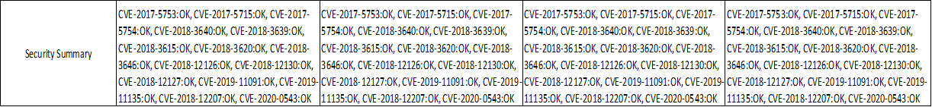
WL Performance – Security Mitigation
Reference:
https://github.com/speed47/spectre-meltdown-checker
https://goto/svr_info
Config1 Config2 Config3 Config4
 | Scenario 1 | Scenario 2 | Scenario...
System config | Link or paste | Link or paste | Link or paste
Security mitigation | Link or paste | Link or paste | Link or paste
7

Slide 8
WL Performance – Performance measuring and tools NOTES
Performance Measuring:
5 runs, average and standard deviation, expected variation(std/avg)
Median value as final value.
Use comma to split every 3 digits for > 3-digit integer number, ex 1,234,567.
Remove decimal for > 4-digit integer number.
Performance monitoring and anlaysis tools:
emon, collectd, perf, vtune, top/htop, sar, turbostat, iostat and etc.
Check CPU sensitivity, memory sensitivity, io sensitivity and other aspects.
Log file names: Workload_Platform_SKU_cores_OtherConfigs.xxx
8

Slide 9
WL Performance – Raw Performance Results page 1, 2, 3,..., or as backup pages
Reference, baseline, core scaling, instance scaling, optimized, Bare metal, Cloud, Gen-to-Gen, Competitive Analysis:
Results | Median | Average | Standard Deviation | RSD | Max-Min Variation | run1 | run2 | run3 | run4 | run5
Transaction | 90,278 | 90,281 | 83.82 | 0.13% | 0.26% | 90,278 | 90,401 | 90,164 | 90,280 | 90,282
 |  |  |  |  |  | run_id1 link | run_id2 link | run_id3 link | run_id4 link | run_id5 link
Utilization Data |  | Average | Standard Deviation | RSD | Max-Min Variation | run1 | run2 | run3 | run4 | run5
CPU op freq |  | 3.300 | 0.007 | 0.21% | 0.0001% | 3.300 | 3.290 | 3.310 | 3.300 | 3.300
CPU utilization(U+K) |  | 99.38 | 0.11 | 0.11% | 0.21% | 99.48 | 99.4 | 99.27 | 99.37 | 99.39
CPU utilization(K) |  | 17.95 | 0.03 | 0.17% | 0.33% | 17.96 | 17.98 | 17.92% | 17.94 | 17.96
Performance Measuring:
5 runs, average and standard deviation, expected variation(std/avg)
Median value as final value.
Use comma to split every 3 digits for > 3-digit integer number, ex 1,234,567.
Remove decimal for > 4-digit integer number.
Performance monitoring and analysis tools:
emon, collectd, perf, vtune, top/htop, sar, turbostat, iostat and etc.
Check CPU sensitivity, memory sensitivity, io sensitivity and other aspects.
Log file names: Workload_Platform_SKU_cores_OtherConfigs.xxx
9

Slide 10
WL Performance – Monitoring data files
Reference Comparison:
Industry, Cumulus WL, PAIV WL, NPG WL, WL from P2CA, WL from Ingredient teams.
No or minimal overhead by containerization.
 | Scenario 1 | Scenario 2 | Scenario...
emon | Link or paste | Link or paste | Link or paste
perf | Link or paste | Link or paste | Link or paste
collectd | Link or paste | Link or paste | Link or paste
sar | Link or paste | Link or paste | Link or paste
...
10

Slide 11
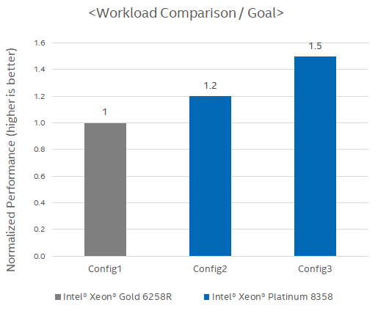
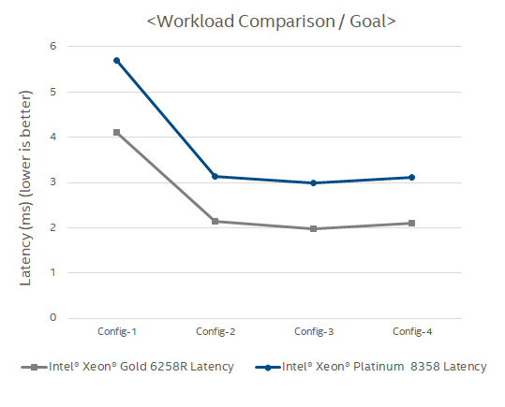
WL Performance - Bare Metal Scaling - Reference comparison
Reference Comparison:
Industry, Cumulus WL, PAIV WL, NPG WL, WL from P2CA, WL from Ingredient teams.
No or minimal overhead by containerization.
 | Reference | Baseline
Configuration 1
Monitoring indicators |  | How saturated?
The data just provide the start point, nice to have.
Backup page for reference comparison in formal report.
Next is to compare inside WSF WL.
11

Slide 12
WL Performance - Bare Metal Scaling - WL Instance scaling
Application instance scaling:
AI instance number and batch size, network packet size, database instance, user and producer, web client number and server worker number and etc.
 | Baseline
Instance scaling 1
Instance scaling 2
Instance scaling 3
12

Slide 13
WL Performance - Bare Metal Scaling - Logical Core scaling
Core scaling:
Logical core number on BM.
AVX, ISA, … monitoring scaling on core scaling
 | Baseline
Core scaling 1
Core scaling 2
Core scaling 3
13

Slide 14
WL Performance - Bare Metal Scaling - Optimization
Analysis, Debug and Optimization:
Low performance? High variation? Low monitoring indicator(perf, emon, sar…)?
Bottle neck is CPU? Memory? IO(Storage, Network)? Are they fully utilized and saturated? None of them is saturated? Any error? Any improvement space?
BIOS, OS kernel parameters
WL Configuration, manual/auto tuning
Code & algorithms level
 | baseline | Improvement
Configuration 1
Configuration 2
Configuration 3
14

Slide 15
WL Performance - Cloud Scaling - Cloud VM instance scaling
Core scaling:
vCPU number on Cloud.
AVX, ISA, … monitoring scaling on core scaling
 | Baseline
VM instance 1
VM instance 2
VM instance 3
15

Slide 16
WL Performance - Cloud Scaling - WL Instance scaling
Application instance scaling:
AI instance number and batch size, network packet size, database instance, user and producer, web client number and server worker number and etc.
 | Baseline
Instance scaling 1
Instance scaling 2
Instance scaling 3
16

Slide 17
WL Performance - Cloud Scaling - Cloud comparison with BM
Cloud vs VM
Need core and frequency normalization for comparison.
Select same core BM and Cloud instance, and use operation frequency to normalization.
Select same core
 | BM | Cloud
Instance 1
Instance 2
Instance 7
17

Slide 18
WL Performance - Gen-to-Gen Comparison (ICX vs SPR)
Gen to Gen comparison:
L
 | Gen1 (ICX) | Gen2 (SPR)
Configuration 1
Configuration 2
Configuration 3
18

Slide 19
WL Performance – SPR hero-features
Hero-features:
Hero-feature enabled/disabled, like encrypt ISA, QAT, AVX, AMX.
 | Baseline | Hero-feature 1 enabled
Instance scaling 1
Instance scaling 2
Instance scaling 3
19

Slide 20
WL Performance - Competitor Analysis
Competitor Analysis:
L
 | XEON | Competitor
Configuration 1
Configuration 2
Configuration 3
20

Slide 21
WL Performance - Conclusion and Nest Step
Performance Result: brief conclusion on result and rational explanation
Performance Analysis: brief conclusion on those impactors to performance.
Next Step: action in next step for unresolved or unfix issues.
21

Slide 22
Template Reference for Perf PDT
Performance PDT Template

